Slide 1
Anomaly Detection and Analysis for Potential Attack: Conn (network connection) Data
Huan Zhao
11/12/2024

Slide 2
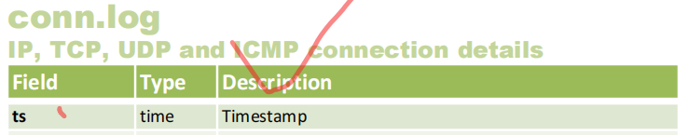
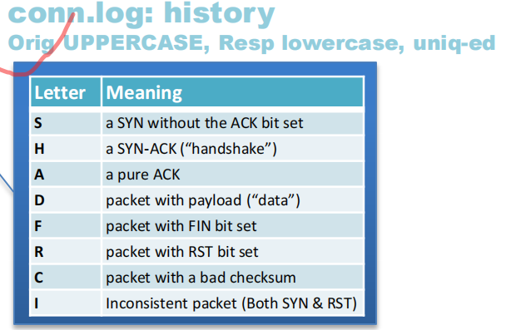
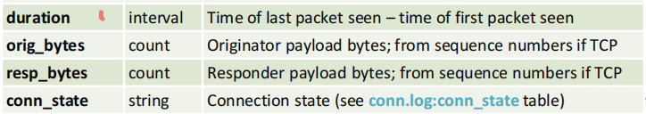
Important features for Conn Data:
'id.orig_h', 'id.resp_h', 'duration', 'orig_bytes', 'resp_bytes', 'orig_pkts', 'resp_pkts', 'conn_state', 'ts'
Notes:
when the Qresult is quarantine, which means that the client is isolated, perhaps because its seen as unsafe or has broken some rules, like maybe the clients send bad email to others so the client is isolated.
reason, if the user renew the dhcp for all the time, its maybe a anomaly behavoir and we want to excavate this.

Slide 3
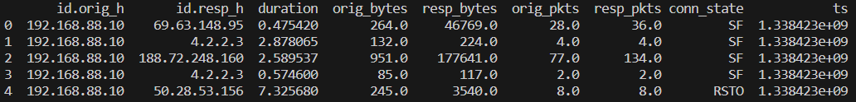
Conn model for one src
Data source:
http://www.secrepo.com/
conn.log.gz (524MB)
Src: ‘192.168.74.10’,
Train Time: 2011-07-22 – 2013-6-30
Predict Time: 2013-7-1 – 2014-03-24
Original data:
Notes:
because we consider the start position of the communication so we build our model for one src

Slide 4
Processed data
Original data
 | id.resp_h | duration_tot | duration_ave | duration_max | orig_bytes_tot | orig_bytes_ave | orig_bytes_max | resp_bytes_tot | resp_bytes_ave | resp_bytes_max | orig_pkts_tot | orig_pkts_ave | orig_pkts_max | resp_pkts_tot | resp_pkts_ave | resp_pkts_max | S0 | S1 | REJ
8/17/2011 | 24 | 861 | 5.937931034 | 35 | 14550 | 100.3448276 | 1919 | 14550 | 100.3448276 | 1919 | 660 | 4.551724138 | 195 | 525 | 3.620689655 | 289 | 29 | 0 | 0
9/10/2011 | 25 | 251 | 0.731778426 | 60 | 168507 | 491.2740525 | 1520 | 168507 | 491.2740525 | 1520 | 3555 | 10.36443149 | 277 | 4350 | 12.68221574 | 392 | 1 | 17 | 0
10/3/2011 | 18 | 334 | 7.76744186 | 64 | 21853 | 508.2093023 | 3904 | 21853 | 508.2093023 | 3904 | 930 | 21.62790698 | 265 | 1294 | 30.09302326 | 401 | 1 | 2 | 0
10/9/2011 | 14 | 458 | 13.87878788 | 63 | 43862 | 1329.151515 | 9039 | 43862 | 1329.151515 | 9039 | 1407 | 42.63636364 | 423 | 1995 | 60.45454545 | 627 | 1 | 13 | 0
10/18/2011 | 8 | 148 | 10.57142857 | 62 | 8857 | 632.6428571 | 2433 | 8857 | 632.6428571 | 2433 | 649 | 46.35714286 | 208 | 942 | 67.28571429 | 313 | 1 | 1 | 0

Slide 5
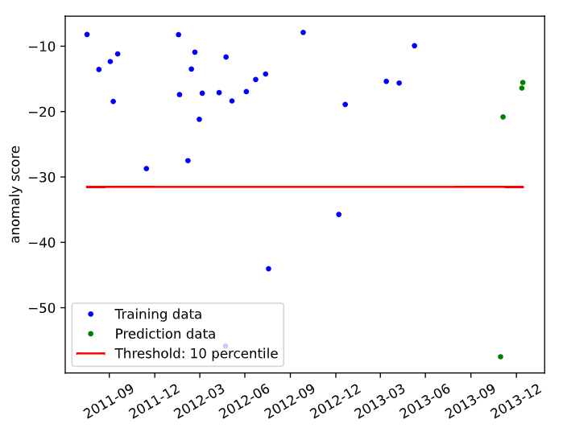
Conn model for one src
Anomaly score for approximate 3 years
Threshold: 10 percentile
Anomaly dates:
Training
5/23/2012
8/18/2012
1/7/2013
Predict
11/30/2013

Slide 6
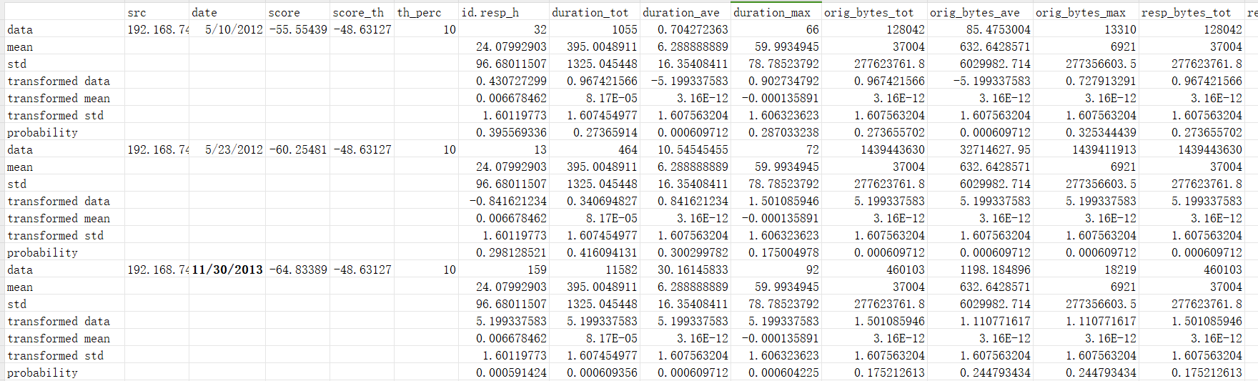
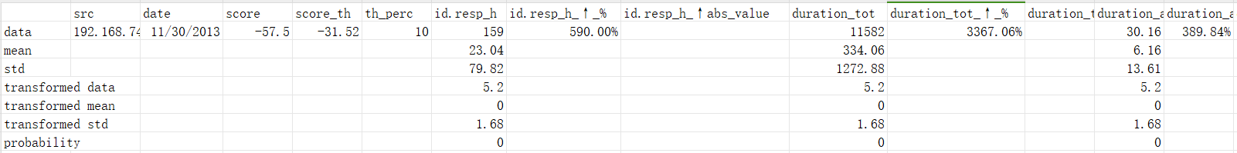
Alerts table

Slide 7
Thank you

